Slide 1
VISION FOR BLIND
Slot TD1
Group 6
CHIRAG GAUR(18BEC0021)
ASHWINI SINGH(18BEC0037)
HARSH RAJ(18BEC0070)
ABHYUDAY TRIPATHI(18BEC0085)
SKAND VIJAY(18BEC0089)
PARTH BANSAL(18BIT0328)
BISHAL GUPTA(18BCE2460)

Slide 2
Facial Recognition ???
It requires no physical interaction on behalf of the user.
It is accurate and allows for high enrolment and verification rates.
It can use your existing hardware infrastructure, existing camaras and image capture Devices will work with no problems

Slide 3
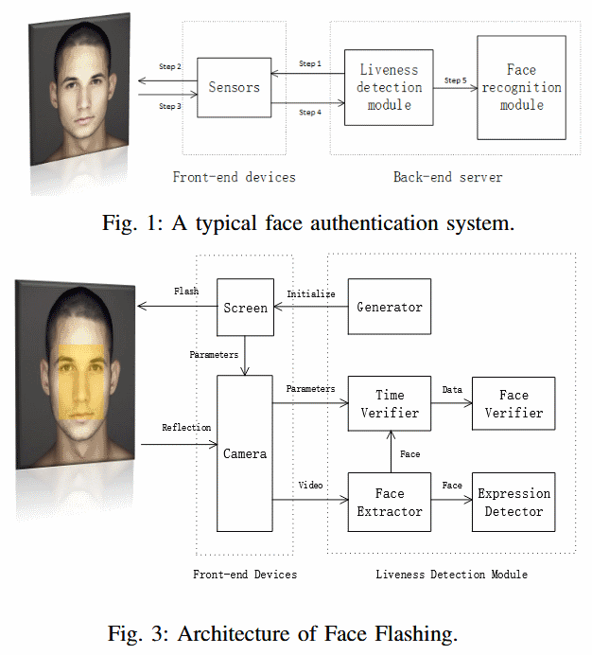

Slide 4
Facial Recognition
In Facial recognition there are two types of comparisons:-
VERIFICATION- The system compares the given individual with who they say they are and gives a yes or no decision.
IDENTIFICATION- The system compares the given individual to all the Other individuals in the database and gives a ranked list of matches.

Slide 5
Contd…
All identification or authentication technologies operate using the following four stages:
Capture: A physical or behavioural sample is captured by the system during Enrollment and also in identification or verification process.
Extraction: unique data is extracted from the sample and a template is created.
Comparison: the template is then compared with a new sample.
Match/non-match: the system decides if the features extracted from the new Samples are a match or a non match.

Slide 6
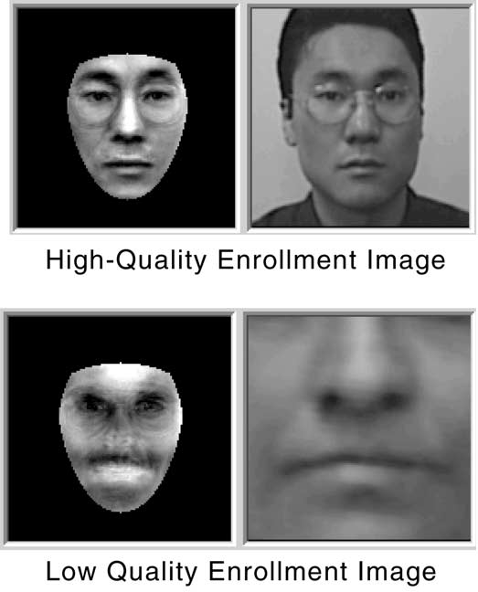

Slide 7
How Facial Recognition System Works
Facial recognition software is based on the ability to first recognize faces, which is a technological feat in itself. If you look at the mirror, you can see that your face has certain distinguishable landmarks. These are the peaks and valleys that make up the different facial features.
VISIONICS defines these landmarks as nodal points. There are about 80 nodal points on a human face.

Slide 8
Contd..
Here are few nodal points that are measured by the software.
distance between the eyes
width of the nose
depth of the eye socket
cheekbones
jaw line
chin

Slide 9
Strengths
It has the ability to leverage existing image acquisition equipment.
It can search against static images such as driver’s license photographs.
It is the only biometric able to operate without user cooperation.

Slide 10
Weaknesses
Changes in acquisition environment reduce matching accuracy.
Changes in physiological characteristics reduce matching accuracy.
It has the potential for privacy abuse due to noncooperative enrollment and identification capabilities.

Slide 11
Applications
Replacement of PIN, physical tokens
No need of human assistance for identification
Prison visitor systems
Border control
Voting system
Computer security
Banking using ATM
Physical access control of buildings ,areas etc.

Slide 12
Disadvantage
Problem with false rejection when people change their hair style, grow or shave a beard or wear glasses.
Identical twins

Slide 13
Conclusion
Factors such as environmental changes and mild changes in appearance impact the technology to a greater degree than many expect.
For implementations where the biometric system must verify and identify users reliably over time, facial scan can be a very difficult, but not impossible, technology to implement successfully.

